Slide 1
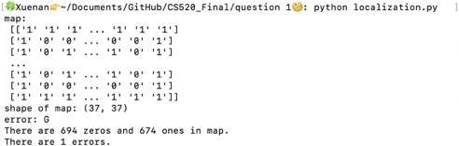

Slide 2

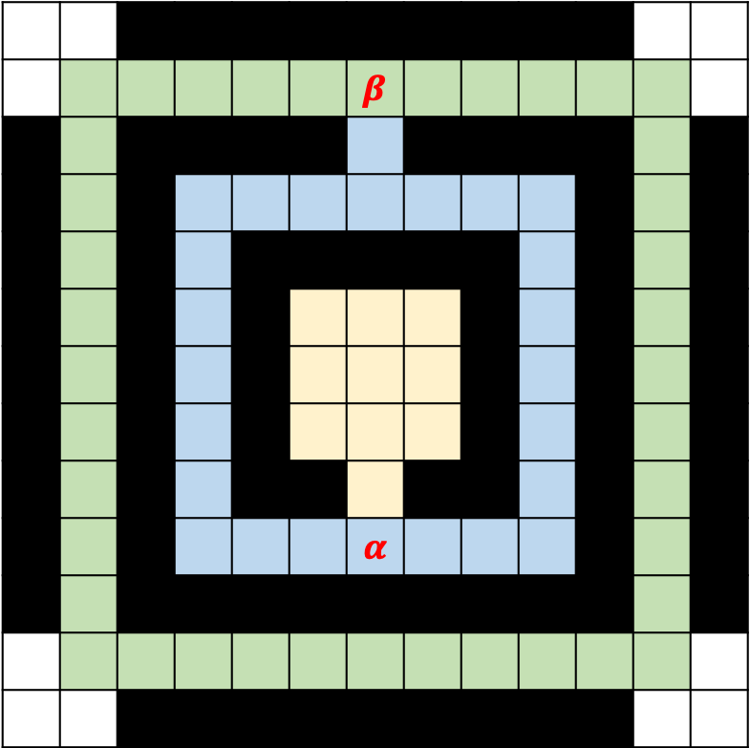
 |  |  |  |  |  | $$β$$
 |  |  |  |  |  | $$α$$

Slide 3
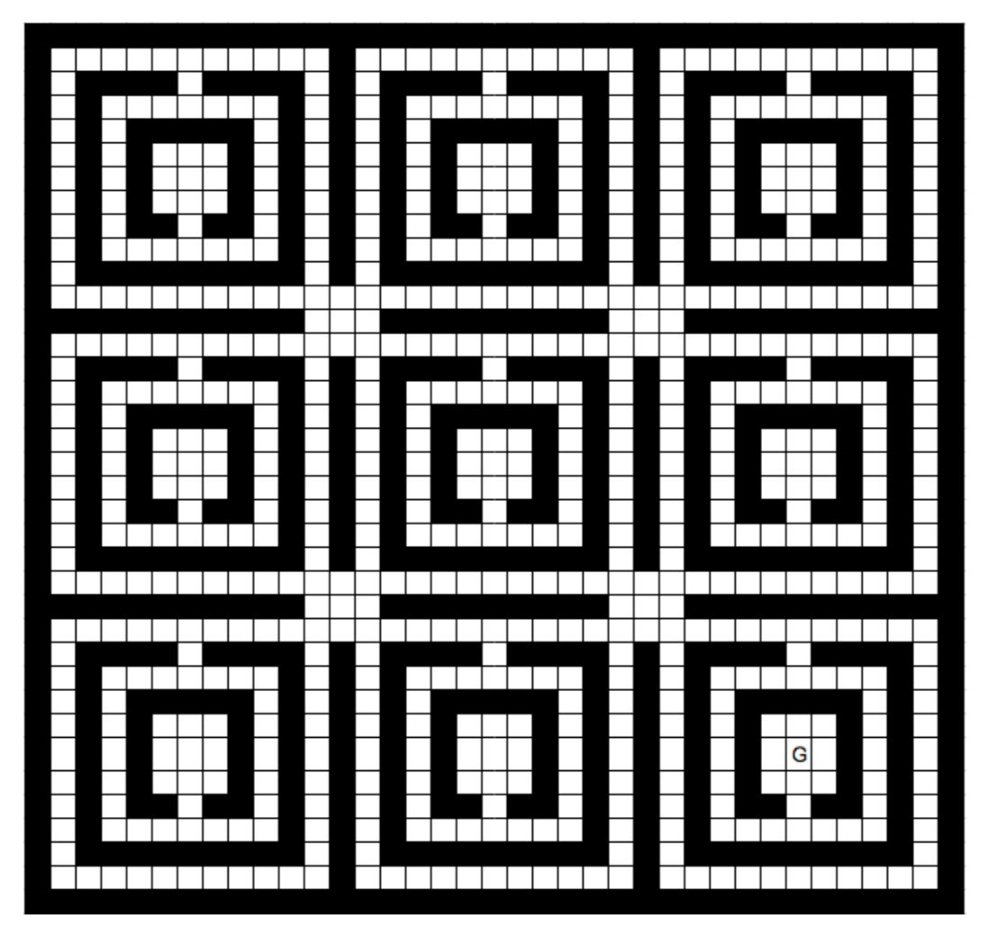
1
2
3
4
5
6
7
8
9

Slide 4
1

Slide 5
1

Slide 6
1

